Slide 1

BOOK STORE
DATABASE
CONNECTIVITY APPLICATION
Prepared By:
Name- Anurag Dev
Enrollment ID- 60314803116
Branch- Information Technology
Group- I 6
College- MAIT Delhi

Slide 2

CONTENTS
Overview
Python Introduction
SQL Introduction
Front End
Back End
Application Features
References

Slide 3

Overview
This application uses 2 languages one is Python and other is SQL. Python forms the basis for this application. SQL is used for connecting it to database.
It is divided in 2 parts: 1. Front End and 2. Back End
Front end forms the GUI part of the application.
Back end forms the database and information part of the application
Library of Python used for GUI implementation is Tkinter.
Library of Python used for implementing SQL commands is Sqlite3.
This application is very simple to use and is used to manipulate book database by a user.

Slide 4


Slide 5
Python Introduction
Python is a high level ,interpreted and object oriented programming language developed by Guido Van Rossum and released in 1991.
Python is based on ABC programming language that itself is based on SETL.
The name of Python language was inspired from BBC TV show Monty Python Flying Circus.
Python is dynamically typed and easy to learn programming language.
Python has automatic memory management.
Python has various applications in real world like,
1. Hacking
2. Web Development
3. Machine Learning
4. Game Development
5. Android Development and many more…

Slide 6
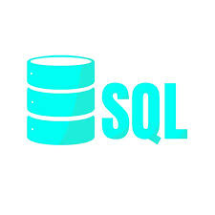

Slide 7
SQL Introduction
Structured Query Language (SQL) was developed in the early 1970s at IBM by Raymond Boyce and Donald Chamberlin.
SQL is used for relational database management and data manipulation.
SQL is used to create database and to query, insert, update and modify data stored in database.
SQL queries are generally divided into 3 main categories:
1. Data Definition Language (DDL) like CREATE, ALTER, DROP, etc.
2. Data Manipulation Language (DML) like SELECT, INSERT, UPDATE, DELETE, etc.
3. Data Control Language (DCL) like GRANT and REVOKE

Slide 8
Front End
Front End part of this application contains Graphical User Interface (GUI) which makes it user friendly and simpler to use.
GUI is implemented using Tkinter module of Python.
Many interactive widgets are used in this application like Entry or Textboxes, Buttons, Scrollbar, List boxes, Labels.
It is the execution part of this application.
User can add, delete, update, view entries of books in the database by using these widgets.
This end of the application is visible to user.

Slide 9
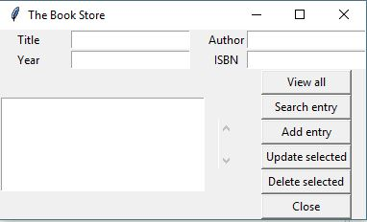
This is the Front End of this application:

Slide 10
Back End
Back End part of this application contains the relational database and information about book records present in book store.
It is manipulated and created using SQL.
Sqlite3 library of Python is used for implementing SQL.
The database is stored in books.db file in the same folder where the project files are stored.
Back End part of the application remains hidden from user in background.
User uses various queries like Select, Insert, Update, Delete for various data manipulation operations in relational database.

Slide 11
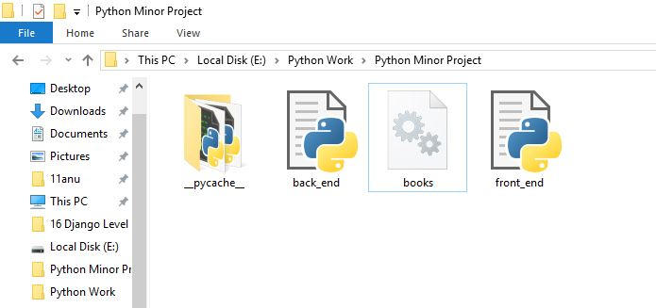
This is the Back End part of this application:
Title | Author | Year | ISBN
2 States | Chetan Bhagat | 2008 | TS123
Love Story | Erich Sehgal | 1970 | LS123
Wings of Fire | APJ Abdul Kalam | 1999 | WOF123
Let us C | Yashvanth Kanetkar | 2016 | LUC123
Relational Database
Books.db file

Slide 12
Application Features
View All Entries : This button allows user to view values of all attributes of entries at once that are present in database of this application.
Search Entry: This button allows user to search a particular entry from the database according to value of the attribute or attributes supplied by the user. The user has to enter the value of any of the attributes of the entry he/she wishes to search and then click on “Search Entry” button. After clicking the button the desired entry will appear in the List Box.
Add Entry: User can add new entry in the books database by filling the value of attributes for new entry in the textboxes and then click “Add Entry” button to add that entry in database.
Update Selected: User can update the values of attributes of any previously stored entry in the database. First the desired entry must be searched by user and then values of its attributes are updated and then click on “Update Selected” button to save changes to database.

Slide 13
5. Delete Selected: User can also delete any previously stored entry from database by searching that entry and then selecting that entry in List Box and then click on “Delete Selected” button to delete that entry.
6. Close: After all work of user is done application window can be closed either by clicking on “Close” button or clicking on cross button at the top right corner of the window.

Slide 14
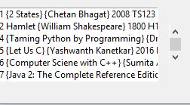
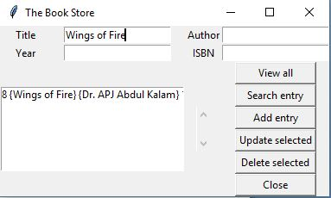
This is the output for “View All” button.
This is the output for “Search Entry” button

Slide 15
References
Google Images: https://www.google.co.in/imghp?hl=en&tab=wi&authuser=0
Tutorials Point:
https://www.tutorialspoint.com/python/python_gui_programming.htm
https://www.tutorialspoint.com/sqlite/sqlite_python.htm
3. Wikipedia:
https://www.wikipedia.org/
4. Udemy:
https://www.udemy.com/complete-python-bootcamp/

Slide 16


